Slide 1

South Carolina Prevention Evaluation Handbook

Slide 2
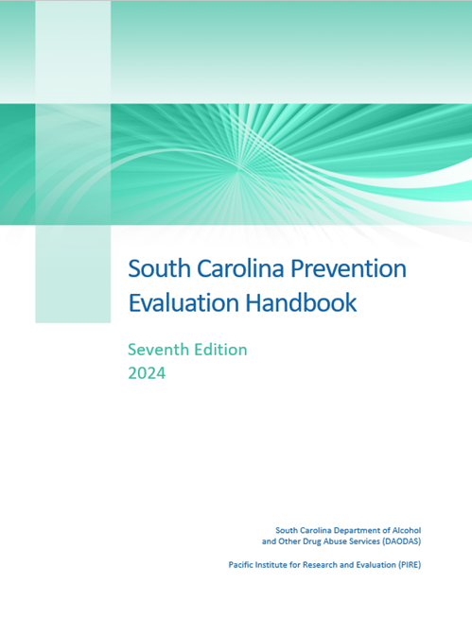
Why Update the Handbook
Previous version of the Handbook is at least 4 years old.
Before 2019 version was 10 years old.
The revised version is more specific to South Carolina data collection systems and protocols—previous version was more general because fewer systems were in place in South Carolina

Slide 3
Contents of the Handbook
Overview of Evaluation
Prevention Strategies and the DAODAS Reporting Systems
  DAODAS Grants Management System (GMS)
  DAODAS Pre-Post Survey
  Data Collection (DAODAS Portal)

Slide 4
Contents of the Handbook (continued)
Understanding the DAODAS Standard Survey
Other Evaluation Issues
  Fidelity Checklists
  Follow up Designs
  Comparison Groups
Conducting Community Surveys
Discussion concerning Community data & evaluation

Slide 5
Concept of Change AKA Theory of Change
Increased attention to the social availability of alcohol to youth
Reduced social availability of alcohol to youth
Reduced overall youth consumption of alcohol

Slide 6
OVERVIEW OF EVALUATION: Evaluation Goals and Objectives
Writing actionable and measurable goals and objectives information for the GMS system can be found at the SC Prevention/Evaluation Resources webpage, also known as the SC Prevention Documents website.
Example:
Goal 1. Reduce substance use among middle and high school students
Objective 1 (Process) | Execute MOUs with three middle schools in our county to deliver Life Skills Training to all 7th grade students.
Objective 2 (Process) | Deliver all eight sessions of Life Skills Training to all 7th grade students in our county, reaching approximately 200 students.
Objective 3 (Outcome) | Reduce alcohol use among program participants, as measured by the DAODAS Survey.
Objective 4 (Outcome) | Reduce marijuana use among program participants, as measured by the DAODAS Survey.

Slide 7
DAODAS Reporting Systems
DAODAS Grant Management System (GMS) - a tool for reporting prevention outputs, or counts, of prevention activities and people reached, setting project goals and objectives.
Data Collection Reporting System - designed to collect data for environmental prevention operations.
DAODAS Pre-Post Survey - primary method for collecting individual-level data from prevention program participants (e.g., students participating in Life Skills).

Slide 8
PREVENTION STRATEGIES:
Six CSAP Strategies
Information dissemination
Prevention education
Positive alternatives
Environmental strategies
Community-based processes
Identification of problems and referral of services

Slide 9
Information Dissemination
Speaking Engagements** **Ones highlighted in red require demographics
Health Fairs and Other Health Promotion **
Social Media Postings- requires number of views/impressions
Media Campaigns- requires number of views/impressions
Radio and TV Public Service Announcements- requires number of views/impressions
Town Hall Meetings **
AET Casual Contacts **
Brochures, Factsheets, Newsletters, Handouts- requires number
MADD Power of Parents **
MADD Power of Youth **
Clearinghouse/Information Resource Centers **

Slide 10
Community-Based Processes **Ones highlighted in red require demographics
Multi‐Agency Coordination/Collaboration/Coalition Meetings**
Youth Boards/Coalitions Meetings **
Community and Volunteer Training/Technical Assistance **
Systematic Planning- require staff hours
Needs Assessment- require staff hours
Accessing Funding/Grant writing- require staff hours
Recognition Activities **
Education
Educational Services for Youth
Education Services for Adults
Parenting and Family Management

Slide 11
Alternatives (all require demographics)
Alcohol and Drug Free Social & Recreational Events
Team Building Activities/Ropes Courses
Program ID & Referral (all require demographics)
Tobacco Education Program
Tobacco Cessation Programs
Diversion Programs
Employee Assistance Programs
Student Assistance Programs

Slide 12
Environmental –
Compliance Check Shoulder Tap Operations
Merchant Education Public Policy Efforts
Synar Study Bar Checks/Fake Id Sweeps
Prescription Drug Deactivation Events
Prescription Drug Drop Boxes
Prescription Drug Lock Boxes (Storage)
Prescription Drug Take Back Events
Controlled Party Dispersals
Public Safety Checkpoints
Public Safety Saturation Patrols
Promoting The Establishment Or Review Of Alcohol, Tobacco And Drug Use Policies In Schools/Workplace

Slide 13
Understanding the DAODAS Standard Survey
A detailed overview of how to prepare, proctor, review, handle, and return the surveys can be found in the “Scanned Standard Survey Overview” document in the Evaluation Documents section of the South Carolina Prevention/Evaluation Resources website.
Administering the Surveys

Slide 14
Understanding the DAODAS Standard Survey
The Standard Survey was updated in 2019 & again in 2023. It is available in four versions— middle school and high school & online and printed copy. Both surveys consist of the following measures:
Perceived risk/harm of substance use.
Disapproval of substance use.
Perceived parental attitudes toward substance use.
Perceived peer attitudes toward substance use.
Decision-making.
Past 30-day substance use.
Past 2-week binge drinking.
Parent communication about the dangers of substance use.

Slide 15
Differences between the New Survey and the Old Survey
Old | New
One pre and one post for ages 10 - 20 | MS pre (grades 6-8), MS post, HS pre (grades 9 – 12), HS post
Scale scores don’t necessarily match standards set by other surveys | Scales more closely match CTC Survey and other standardized surveys
Scale scores vary (e.g., 0 – 3, 0 – 10) | All scales are scored 0 - 3
Same substance use items regardless of age | Fewer substance use items for middle school
Does not include some current substances of concern | Includes e-cigarettes, prescription drugs, pain relievers (HS), heroin and fentanyl (HS), cocaine (HS), other illicit drugs (HS)
Substance use items ask about number of days used during past 30 days | Substance use items are YES/NO
Includes age of first use | No age of first use items

Slide 16
Data Coding
Scale | Coding
Perceived Risk of Harm | No Risk to Great Risk (0 – 3)
Disapproval of Substance Use | Not at all Wrong to Very Wrong (0 – 3)
Perceived Parental Attitudes | Not at all Wrong to Very Wrong (0 – 3)
Perceived Peer Attitudes | Not at all Wrong to Very Wrong (0 – 3)
Decision Making | Never to All the Time (0 – 3)
Past 30-Day Substance Use | YES/NO
Past Two-Week Binge Drinking | YES/NO
Parent Communication | YES/NO

Slide 17
Data Reports
Up to two evaluation reports per program each year
  One at year end
  One upon request at any time during the year

Slide 18
Data Reports (cont.)
The following information is typically provided in each report:
    The number of participants with valid pre- and post-tests;
    A measure-by-measure breakdown of the average pre-test score, average post-test score, and percent change from pre- to post-test;
    Whether the change for each measure was statistically significant;
    A bar chart depicting the percent of pre-test non-substance-users (that is, those who reported not using a given substance during the past 30 days) that remained non-users at post-test;
    A bar chart depicting the percent of pre-test substance users (that is, those who reported using a given substance on at least one day during the past 30 days) that reduced use (that is, reported using on fewer days), though not necessarily stopped entirely, by post-test;

Slide 19
Data Reports (cont.)
The following information is typically provided in each report:
    Bar charts depicting the pre- and post-test scores for each measure;
    Bar charts depicting the results for items on the pre-test only (i.e., age of first use, whether they talked with their parents about ATOD dangers in the past year, and whether they have been exposed to prevention ads in the past year);
    A summary of overall program findings as observed by PIRE staff;
    Sub-group data tables broken down by gender, race, ethnicity and implementation group (but only when the number of participants in the subgroup is at least 25);
    A discussion of differences between sub-groups; and
    A brief description of some of some methodology issues.

Slide 20

Sample Data Table
*Pre- and post-test averages are approaching being statistically significantly different (significant at the p<.10 level, but not p<.05 level)
** Pre- and post-test averages are statistically significantly different (significant at p<.05 level)
Risk Factor Scores, Range (Positive score is favorable) | Your County, This Program N=55 |  |  | All Counties, This Program N=145 |  |  | FY18 All Counties, All Programs N=545
 | Pre Average | Post Average | % Change | Pre Average | Post Average | % Change | Pre Average | Post Average | % Change
Perceived Risk, 0-3 | 2.38 | 2.43 | 1.81* | 1.96 | 2.16 | 10.11** | 1.92 | 2.07 | 7.61**
Disapproval of Substance Use, 0-3 | 1.95 | 1.88 | -3.79** | 1.86 | 1.91 | 3.16** | 1.81 | 1.85 | 2.18**
Perceived Parental Attitudes, 0-3 | 2.76 | 2.76 | 0.00 | 1.88 | 2.01 | 6.73 | 1.58 | 1.62 | 4.5**
Perceived Peer Attitudes 0-3 | 1.95 | 1.88 | -3.79** | 1.82 | 1.83 | 0.90 | 2.38 | 2.43 | 1.81*
Decision-Making Skills, 0-3 | 2.85 | 2.85 | -0.12 | 2.82 | 2.87 | 1.61** | 2.83 | 2.84 | 0.28

Slide 21
Sample Data Table (cont.)
*Pre- and post-test averages are approaching being statistically significantly different (significant at the p<.10 level, but not p<.05 level)
** Pre- and post-test averages are statistically significantly different (significant at p<.05 level)
Substance Use, % Users in Past 30 Days (Negative change is favorable) | Pre Average | Post Average | % Change | Pre Average | Post Average | % Change | Pre Average | Post Average | % Change
Other Tobacco | 5.06 | 3.13 | -38.14 | 2.42 | 1.91 | -21.07 | 3.23 | 3.52 | 8.98
Cigarettes | 10.13 | 7.81 | -22.90 | 3.35 | 1.91 | -42.99 | 4.45 | 3.36 | -24.49
E-Cigarettes or Vapes | 17.72 | 17.19 | -2.99 | 7.27 | 5.14 | -29.30 | 9.48 | 7.85 | -17.19**
Alcohol | 6.36 | 0.74 | -88.36 | 4.73 | 2.63 | -44.40 | 4.30 | 3.13 | -27.21*
Marijuana | 1.9 | 0 | -100 | 2.31 | 1.67 | -27.71 | 1.80 | 1.31 | -27.22
Non-Medical Prescription Drug Use | 4.13 | 6.62 | 60.29 | 3.46 | 4.06 | 17.34 | 3.55 | 3.01 | -15.21
Prescription Pain Pills (OxyContin, Vicodin, etc.) | 2.18 | 2.21 | 1.38 | 2.31 | 2.15 | -6.93 | 2.44 | 2.22 | -9.02
Heroin or Fentanyl | 2.91 | 4.17 | 43.30 | 2.42 | 1.91 | -21.07 | 1.80 | 1.88 | 4.44
Binge Drinking (past 2 weeks) | 0.98 | 0.98 | 0.00 | 6.36 | 0.74 | -88.36 | 1.73 | 1.68 | -2.89

Slide 22
Fidelity Checklists v Adaptation
Fidelity is the agreement (concordance) of a replicated program model or strategy with the specifications of the original. The primary argument for fidelity is that the developer generated the positive outcomes required to be an evidence-based program by doing the program a certain way, and if the program is not implemented in that way, the likelihood of replicating those positive results is diminished. Indeed, most evaluative evidence suggests that programs that are not administered with fidelity will achieve weaker effects
Adaptation refers to modifications made to a chosen intervention, which may be intentional or unintentional. The primary argument for adaptation is that every community is different, so the implementers must be trusted to make decisions about how the program can work best with their audience.

Slide 23
Community Surveys
Surveys are an excellent way to gather data to assess your community’s behaviors, attitudes, and beliefs.
They allow you to collect information from a lot of people that is not readily available from other sources.
Before you decide to conduct your own survey, however, you should do some research to make sure there are no existing surveys that could provide you with the information you want.
Table on the next slide lists a few prominent surveys relevant for substance abuse prevention that are conducted in South Carolina.

Slide 24
Community Surveys
Survey Name | Sponsoring Agency | Target Population | Frequency | Level of Estimates | Website
Behavioral Risk Factor Survey (BRFS) | SC DHEC), in conjunction with the CDC | Adults ages 18 and older | Annual | State Nation | https://www.scdhec.gov/health/sc-public-health-statistics-maps/behavioral-risk-factor-surveys
Communities That Care (CTC) | DAODAS | High School students | Biannual (even years) | County (a subset of counties participates in this survey) | https://www.communitiesthatcare.net/
National Survey on Drug Use and Health (NSDUH) | SAMHSA | Persons ages 12 and older | Annual | State Nation | https://nsduhweb.rti.org/respweb/homepage.cfm
Monitoring the Future (MTF) | National Institute on Drug Abuse (NIDA) | Grades 8, 10, 12 | Annual | National | http://www.monitoringthefuture.org/
Youth Risk Behavior Survey (YRBS) | SC DOE, in conjunction with the CDC | High School students | Biannual (odd years) | State Nation | https://ed.sc.gov/districts-schools/school-safety/health-safety-surveys/sc-youth-risk-behaviors-survey-yrbs/

Slide 25
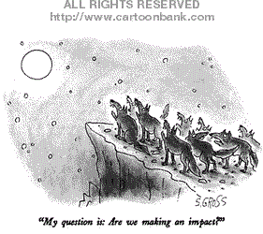
….or are we just howling at the moon!

Slide 26
In the beginning, data based on inputs & outputs….
Inputs
Outputs

Slide 27
Process and Outcome evaluation
Process evaluation describes services, activities, policies, and procedures meant to appraise a program
Outcome evaluation measures a program’s results and determines if intended results were achieved.
James Bell Associates (2021).

Slide 28

Types of data
Quantitative Data | Qualitative Data
Associated with numbers | Associated with details
Implemented when data is numerical | Implemented when data can be segregated into well-defined groups
Collected data can be statistically analyzed | Collected data can be observed and not evaluated
How much? How often? Rate 1-5 scale, other statistics | How? Why? Describe… Tell me more….
Examples: height, weight, time, price, temperature | Examples: scents, appearance, beauty, colors, flavors
https://www.questionpro.com/blog/quantitative-data/

Slide 29
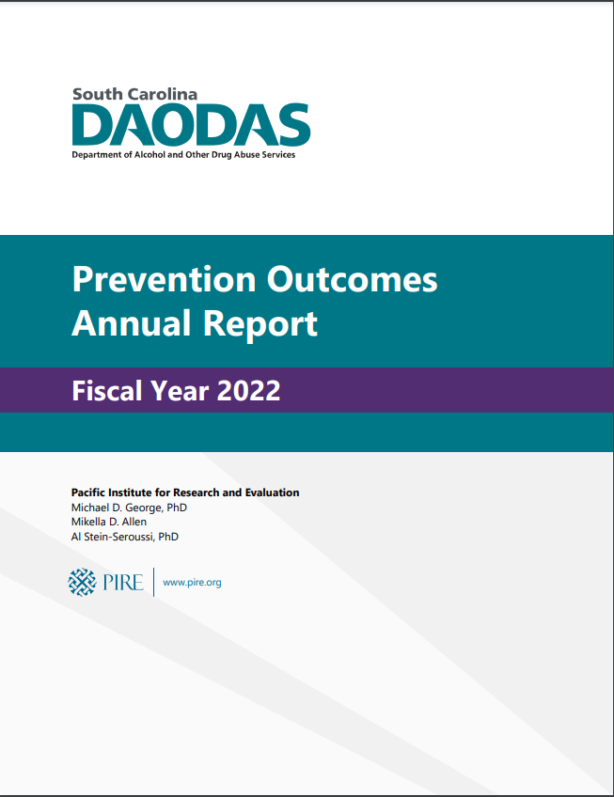
Annual Outcomes Report
Reports back to 2005 at South Carolina Prevention/Evaluation Resources under DATA

Slide 30

What do I mean?
Community is a loose term that describes a specific area of a jurisdiction, the entire jurisdiction, or other governmental area (county, state, or United States)
Data are individual pieces of factual information recorded and used for the purpose of analysis. It is the raw information from which statistics are created.
Community Data

Slide 31
Need for local data
Determines:
Changes in key intermediate variables
Implementation and strength (dosage) of planned interventions following the strategic plan
Effects or changes in targeted outcomes

Slide 32
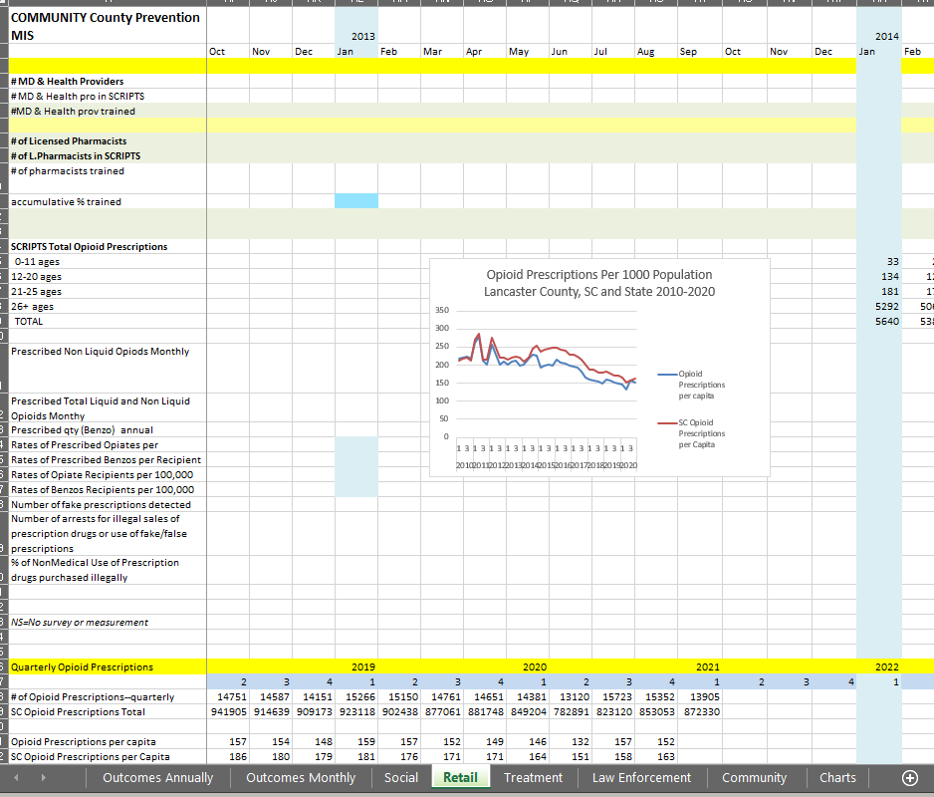
Management Information System (MIS) for Community data

Slide 33
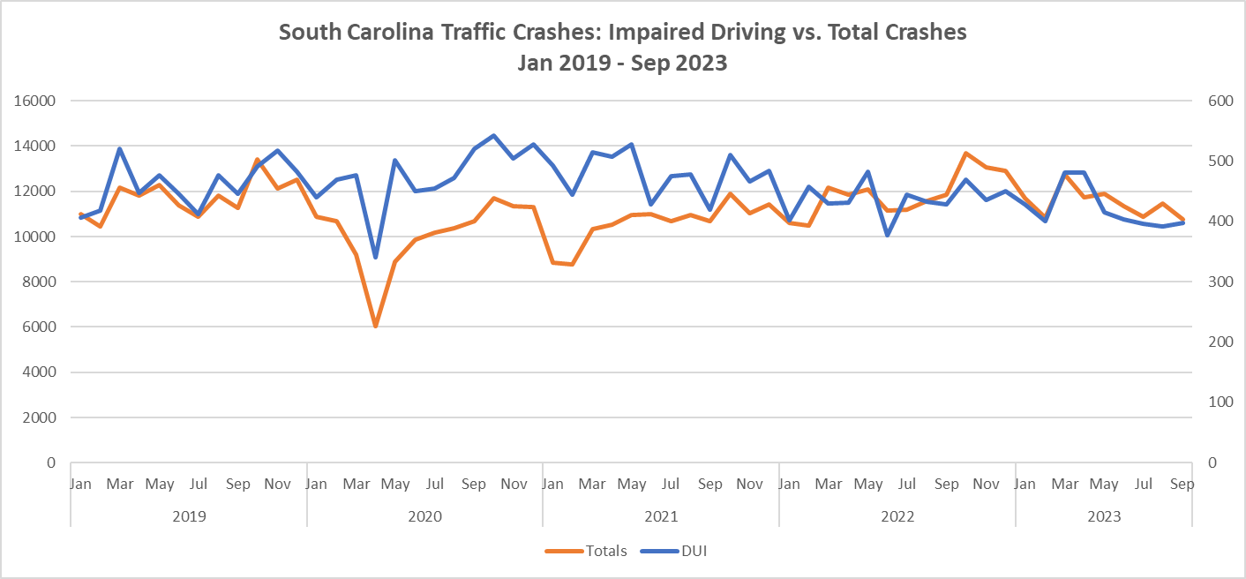




2019 to Mar. 2020 avg.
461 DUI crashes monthly
2019 to Mar. 2020 avg.
10,981 overall crashes monthly
May 2020 - Mar. 2021 avg.
476 DUI crashes monthly
May 2020 – Mar. 2021 avg.
9,479 overall crashes monthly
Apr. 2021 - Dec. 2023 avg.
444 DUI crashes monthly
Apr. 2021 – Dec. 2023 avg.
11,507 overall crashes monthly
Impaired Driving crashes followed Total crashes more closely and in Mar 2023, dropped below

Slide 34
FY2008 – FY2022 Enforcement Numbers
* July 1, 2007, through June 30, 2022
Activity | FY2008-2020 | Activity | FY2008-2020
Compliance Checks | 101,547 | Compliance Check Sales | 11,973
Public Safety Checkpoints | 9,751 | Bar checks | 4,311
Saturation Patrols | 3,446 | # of Parties Prevented | 1,822
Party Dispersals | 1,899 | Merchant Education | 20,096
Media Contacts | 102,774 | Shoulder Taps | 341
** Enforcement & Education numbers are collected in “real-time”, but FY 2023 numbers are not included in this count

Slide 35

Final Thoughts
Problem solving - follow model
Trend Data – monthly when possible
  Decisions can be made more quickly
  Policies, procedures, and focus areas can be adapted
  Focus is on trends (decreases or increases), so a simple analysis with group thought about changes is conducted
Local evaluation brings stakeholders together

Slide 36
Resources
Communities That Care
Information on their approach, including their Youth Survey
Community Tool Box
Information on conducting surveys
Harvard University Program on Survey Research
Tip Sheet on Question Wording
Questionnaire Design: Asking Questions with a Purpose from the University of Wisconsin
Search Institute
Information on their approach, including their Developmental Assets Profile
Survey Monkey
Surveys 101

Slide 37
PIRE South Carolina Team
Michael George, PhD
mgeorge@pire.org
803.479.3628
Mikella Allen
mallen@pire.org
Al Stein-Seroussi, PhD
stein@pire.org
919.265.2616
PIRE staff are available to provide evaluation-related assistance to the county prevention staff. If you need further assistance or clarification on any of the information in this handbook, please feel free to contact the DAODAS prevention staff at 803-896-1184 or PIRE staff. We would also appreciate your feedback so that we can further develop the handbook in future editions.

